Slide 1
Failure-Aware and Confidence-Calibrated Adaptive Retrieval-Augmented Generation System 23CSE399 Project Phase 1 – Approval Presentation Team ID: 23UG031 Panel No.:20
S.No | Reg.No | Name of the Student | Branch
1 | BL.EN.U4CSE23246 | Siddhartha Ravva | CSE
2 | BL.EN.U4CSE23206 | Aman Aggarwal | CSE
3 | BL.EN.U4CSE23222 | Harsh Vardhan Singh | CSE
4 | BL.EN.U4CSE23043 | Pratyush Swain | CSE
Project Guide:Dr. Sajitha Krishnan
Assistant Professor

Slide 2
Screenshot of your guides’ approval mail (to go ahead with the presentation)

Slide 3
Problem Definition
Retrieval-Augmented Generation (RAG) enhances the quality of responses by retrieving relevant documents from external sources based on the similarity of embeddings.
However, the current RAG models rely only on the similarity scores for ranking documents and do not evaluate the reliability of the retrieved results or identify retrieval failure.
This leads to the possibility of substandard, inconsistent, or irrelevant results being retrieved unnoticed, resulting in hallucinations and unreliable responses.
There is a need for a framework for retrieval failure detection that represents retrieval failure signals such as similarity score, consistency of top-k similarity, and retrieval agreement.
This paper proposes the design of a retrieval failure signal estimation module to calculate
retrieval reliability and retrieval failure.

Slide 4
Literature Survey
S.No. | Authors name(s) | Full title of the paper with year | Inference from the paper | Open Problem (For proposed work)
1 | Hadi Soudani, François Yvon, et al. | Why Uncertainty Estimation Methods Fall Short in Retrieval-Augmented Generation, 2025 | Traditional uncertainty estimation (UE) fails in RAG systems because it ignores non-parametric retrieved knowledge. The paper defines axiomatic constraints for reliable UE and shows that most existing methods violate them. | Current UE methods rely only on model outputs and ignore retrieval quality, evidence consistency, and grounding. A retrieval-aware, calibrated uncertainty framework is needed for reliable RAG systems.
2 | Leandre Ngartera, Ahmed Abdelaziz, et al. | Bayesian RAG: Uncertainty-Aware Retrieval for Reliable Financial Question Answering, 2026 | Bayesian RAG models retrieval uncertainty using Monte Carlo Dropout and probabilistic embeddings, improving calibration, and reducing hallucinations. | It ignores generation instability and adaptive control. A unified uncertainty framework is needed.

Slide 5
Literature Survey
S.No. | Authors name(s) | Full title of the paper with year | Inference from the paper | Open Problem (For proposed work)
3 | Michael Oehri, Jannis Vamvas, et al. | Trusted Uncertainty in Large Language Models: A Unified Framework for Confidence Calibration and Risk-Controlled Refusal, 2025 | This paper proposes a unified framework combining sequence likelihood, semantic entropy, and self-consistency to produce calibrated confidence scores, along with risk-controlled refusal mechanisms.. | it does not incorporate retrieval-aware uncertainty or adaptive retrieval. A RAG system that dynamically adjusts retrieval, generation, and responses based on confidence is needed.
4 | Lewis, P., Perez, E., Piktus, A., et al. | Retrieval-Augmented Generation for Knowledge-Intensive NLP Tasks, 2020 | Introduces the RAG framework that combines retrieval and generation to improve factual accuracy and reduce hallucinations in knowledge-intensive tasks. | Does not provide calibrated confidence estimation or retrieval-aware uncertainty handling. Adaptive response control based on confidence is still needed.

Slide 6
Justification for the Proposed Problem
The current RAG models employ similarity scores for ranking but lack the ability to identify retrieval failure explicitly.
The recent models like Self-RAG and CRAG assess the quality of retrieval but lack the ability to compute retrieval reliability explicitly from measurable signals.
This results in the potential of poor retrieval going unnoticed, thereby causing unreliable responses.
There is a requirement for a system that computes the retrieval failure signal based on similarity score, top-k consistency, and retrieval agreement.
The plan for the implementation of the estimation of the retrieval failure signal for the identification of retrieval failures is proposed in this paper.

Slide 7
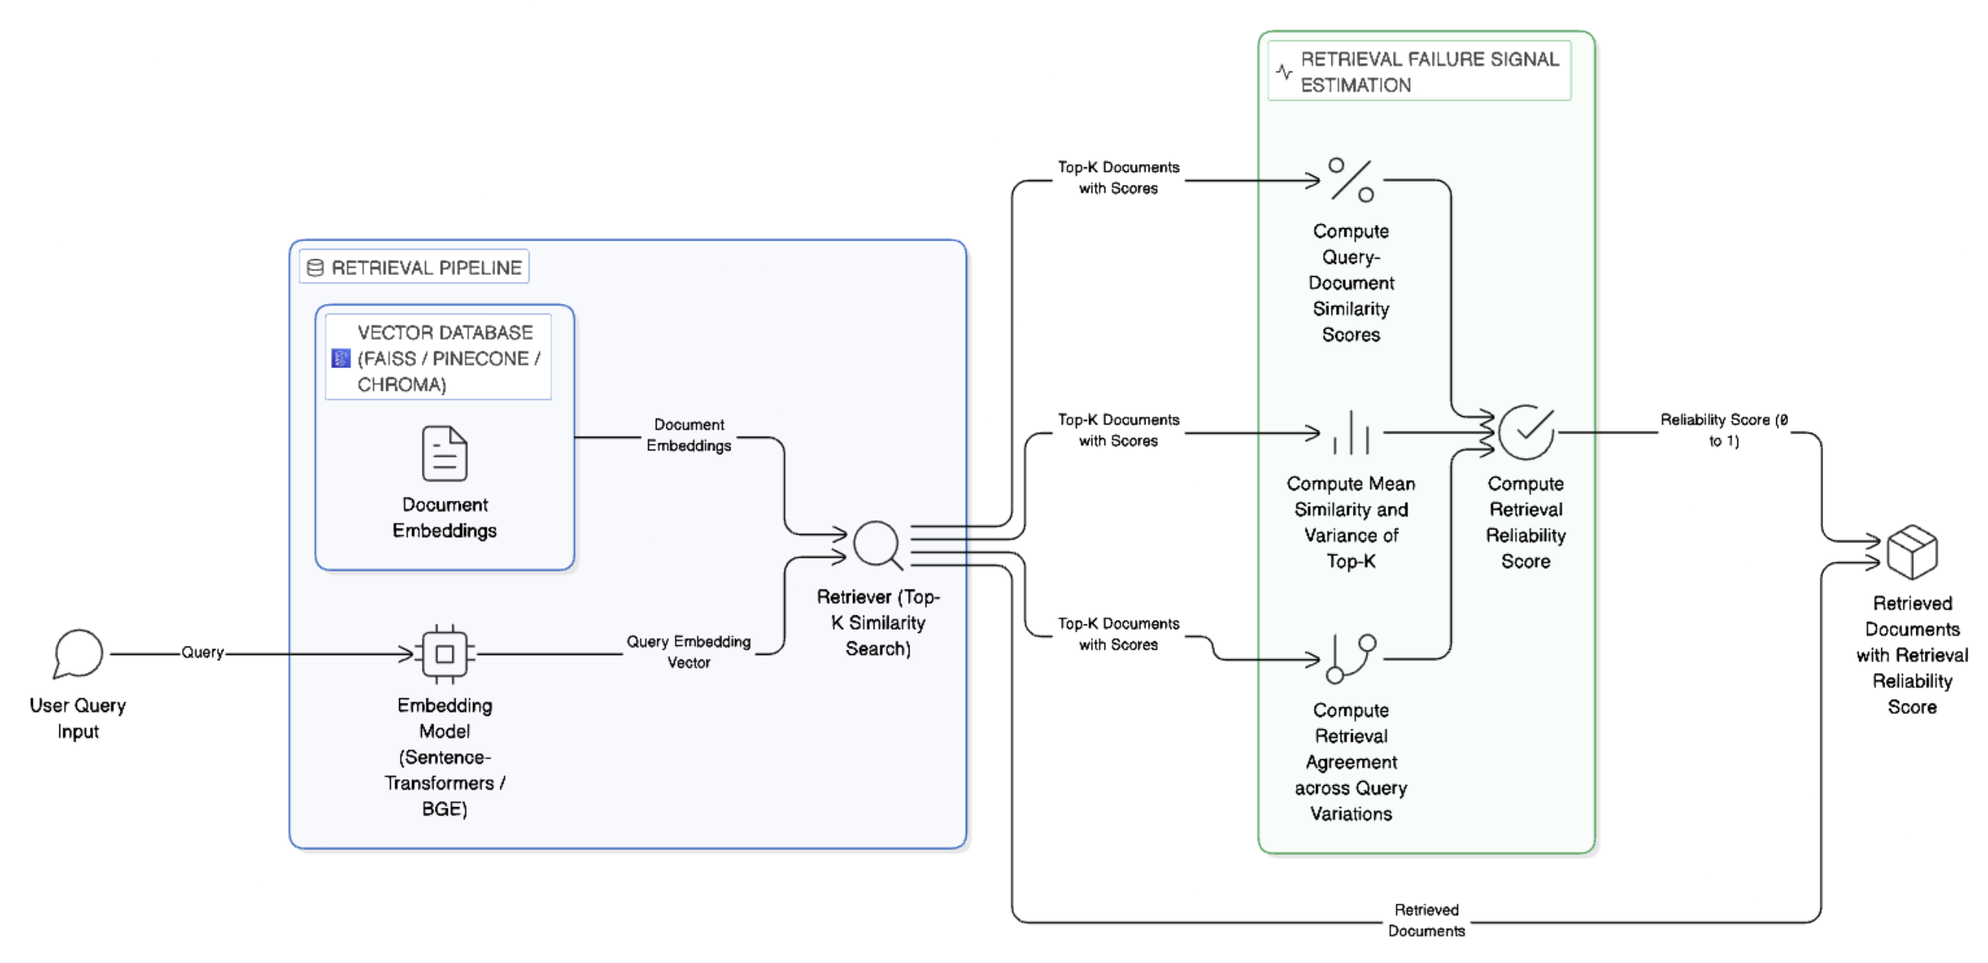
Architecture of the Proposed System

Slide 8
Functionalities of the Proposed System
System capabilities:
Retrieve documents using embedding similarity
Compute query-document similarity scores
Analyze top-k similarity consistency
Compute retrieval agreement signals
Estimate retrieval reliability score
Detect weak or unreliable retrieval
Enable retrieval failure detection

Slide 9
Software/Tools Requirements
Programming Language:
Python
Frameworks:
HuggingFace Transformers
Sentence-Transformers
LangChain / LlamaIndex
FAISS / ChromaDB
Models:
Embedding Model: BGE-large or MiniLM
Generator Model: Mistral-7B (future integration)
Platform:
Kaggle GPU Environment

Slide 10
Data Set
Source of data set:
URL:
https://nlp.cs.washington.edu/triviaqa/
Description:
TriviaQA is a reading comprehension dataset containing over 650K question-answer-evidence triples. TriviaQA includes 95K question-answer pairs authored by trivia enthusiasts and independently gathered evidence documents, six per question on average, that provide high quality distant supervision for answering the questions.

Slide 11
Timeline
Literature Survey
System Architecture Design Finalization
Abstract Submission
Embedding Model Integration and Vector Database Setup
Basic Retrieval Pipeline Implementation
Implementation of Retrieval Similarity Score and Top-K Similarity Consistency Signal
Implementation of Retrieval Agreement Signal
15/4/2026
5/4/2026
5/2/2026
20/3/2026
5/3/2026
17/2/2026
30/4/2026

Slide 12
Conclusion
This work proposes a failure-aware RAG framework to improve system reliability.
This phase focuses on detecting retrieval failures using similarity score, top-k consistency, and retrieval agreement signals.
The system estimates retrieval reliability and enables early detection of weak retrieval.
This forms the foundation for future confidence estimation and adaptive RAG systems.

Slide 13
References
[1] Ngartera, Lebede, Saralees Nadarajah, and Rodoumta Koina. "Bayesian RAG: uncertainty-aware retrieval for reliable financial question answering." (2026).
[2] H. Soudani, E. Kanoulas, and F. Hasibi, "Why Uncertainty Estimation Methods Fall Short in RAG: An Axiomatic Analysis", Findings of the Association for Computational Linguistics, ACL 2025, pp.: 16596–16616, 2025
[3] Oehri, M., Conti, G., Pather, K., Rossi, A., Serra, L., Parody, A., ... & Krasniqi, A. (2025). Trusted Uncertainty in Large Language Models: A Unified Framework for Confidence Calibration and Risk-Controlled Refusal. arXiv preprint arXiv:2509.01455.
[4] Lewis, P., Perez, E., Piktus, A., Petroni, F., Karpukhin, V., Goyal, N., Küttler, H., Lewis, M., Yih, W.T., Rocktäschel, T. and Riedel, S., 2020. Retrieval-augmented generation for knowledge-intensive nlp tasks. Advances in neural information processing systems, 33, pp.9459-9474.

Slide 14
References
[5] Gao, Y., Xiong, Y., Gao, X., Jia, K., Pan, J., Bi, Y., Dai, Y., Sun, J., Wang, H. and Wang, H., 2023. Retrieval-augmented generation for large language models: A survey. arXiv preprint arXiv:2312.10997, 2(1), p.32.
[6] Huang, L., Yu, W., Ma, W., Zhong, W., Feng, Z., Wang, H., Chen, Q., Peng, W., Feng, X., Qin, B. and Liu, T., 2025. A survey on hallucination in large language models: Principles, taxonomy, challenges, and open questions. ACM Transactions on Information Systems, 43(2), pp.1-55.
[7] Zhang, Y., Li, Y., Cui, L., Cai, D., Liu, L., Fu, T., Huang, X., Zhao, E., Zhang, Y., Chen, Y. and Wang, L., 2025. Siren’s Song in the AI Ocean: A Survey on Hallucination in Large Language Models. Computational Linguistics, 51(4), pp.1373-1418.

Slide 15
References
[8] D. Sinha, “The Semantic Illusion: Certified Limits of Embedding-Based Hallucination Detection in RAG Systems,” 2025.
[9] Zhang W, Zhang J. Hallucination Mitigation for Retrieval-Augmented Large Language Models: A Review. Mathematics, 2025
[10] J. Song, X. Wang, J. Zhu, Y. Wu, X. Cheng, R. Zhong, and C. Niu, “RAG-HAT: A Hallucination-Aware Tuning Pipeline for LLM in Retrieval-Augmented Generation,” 2024
[11] P. Lewis, E. Perez, A. Piktus, F. Petroni, V. Karpukhin, N. Goyal, H. Küttler, M. Lewis, W.-t. Yih, T. Rocktäschel, S. Riedel, and D. Kiela, “Retrieval-augmented generation for knowledge-intensive NLP tasks,” in Advances in Neural Information Processing Systems (NeurIPS 2020), vol. 33, 2020.

Slide 16
References
[12] A.Sardana, “Real-Time Evaluation Models for RAG: Who Detects HallucinationsBest?,” 2025.
[13] Z. Sun, X. Zang, K. Zheng, Y. Song, J. Xu, X. Zhang, W. Yu, Y. Song, and H. Li, “ReDeEP: Detecting hallucination in retrieval-augmented generation via mechanistic interpretability,” 2025.
[14] P. Béchard and O. M. Ayala, “Reducing hallucination in structured outputs via retrieval-augmented generation,” 2024.
[15] H. Ding, L. Pang, Z. Wei, H. Shen, and X. Cheng, “Rowen: Adaptive retrieval-augmented generation for hallucination mitigation in LLMs,” 2025

Slide 17
THANK YOU

